Slide 1
GIT & GITHUB
Lecture
Joel Enrique Esparza Ramirez
Internet of Things
Resource: https://www.freecodecamp.org/news/gitting-things-done-book/

Slide 2
GIT HISTORY

Slide 3
INSTALL GIT

Slide 4
CREATE AN ACCOUNT

Slide 5
GITHUB INTRODUCTION

Slide 6
Main Objects
Git objects

Slide 7
blobs
In Git, the contents of files are stored in objects called blobs, short for binary large objects.
Every blob in Git is identified by its SHA-1 hash. SHA-1 hashes consist of 20 bytes, usually represented by 40 characters in hexadecimal form.

Slide 8
Hashes
A hash is a deterministic, one-way mathematical function.
Deterministic means that the same input will provide the same output. That is - you take a stream of data, run a hash function on that stream, and you get a result.

Slide 9
EXAMPLE
For example, if you provide the SHA-1 hash function with the stream hello, you will get 0xaaf4c61ddcc5e8a2dabede0f3b482cd9aea9434d. If you run the SHA-1 hash function again, from a different machine, and provide it the same data (hello), you will get the same value.

Slide 10
SHA-1
Git uses SHA-1 as its hash function in order to identify objects. It relies on it being deterministic, such that an object will always have the same identifier.

Slide 11
Trees
In Git, the equivalent of a directory is a tree. A tree is basically a directory listing, referring to blobs, as well as other trees.
Trees are identified by their SHA-1 hashes as well. Referring to these objects, either blobs or other trees, happens via the SHA-1 hash of the objects.

Slide 12
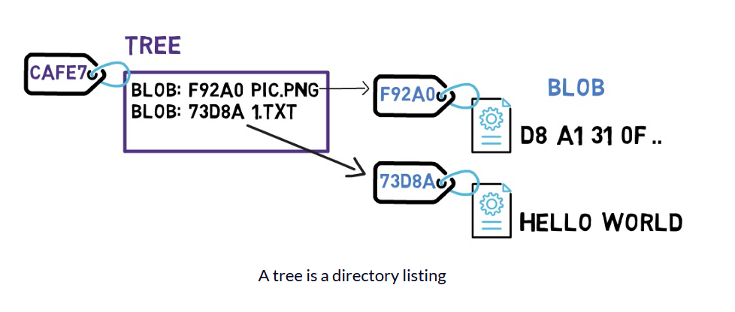

Slide 13
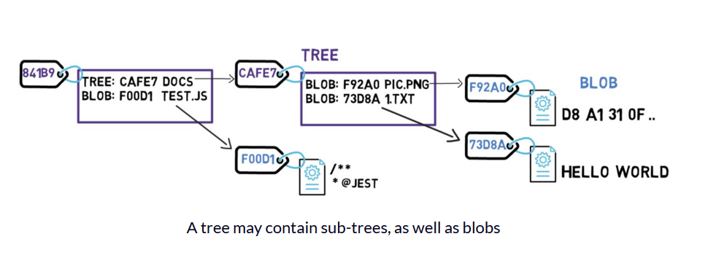

Slide 14
Commit
In Git, a snapshot is a commit. A commit object includes a pointer to the main tree (the root directory of the file system), as well as other meta-data such as the committer (the user who authored the commit), a commit message, and the commit time.

Slide 15
Commit
In most cases, a commit also has one or more parent commits — the previous snapshot (or snapshots). Of course, commit objects are also identified by their SHA-1 hashes. These are the hashes you are probably used to seeing when you use commands such as git log.

Slide 16
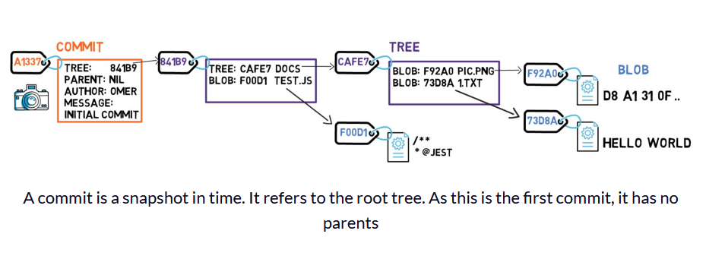

Slide 17
EXAMPLE
Examine what happens if you change the contents of a file. Say that you edit the file 1.txt, and add an exclamation mark — that is, you changed the content from HELLO WORLD, to HELLO WORLD!.
Well, this change means that Git creates a new blob object, with a new SHA-1 hash. This makes sense, as sha1("HELLO WORLD") is different from sha1("HELLO WORLD!").

Slide 18
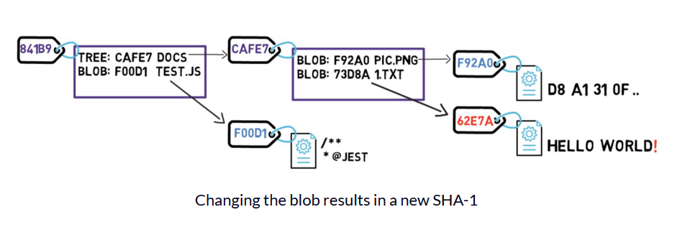

Slide 19
EXAMPLE
Since you have a new hash, then the tree's listing should also change. After all, your tree no longer points to blob 73D8A, but rather blob 62E7A instead. Since you change the tree's contents, you also change its hash.

Slide 20
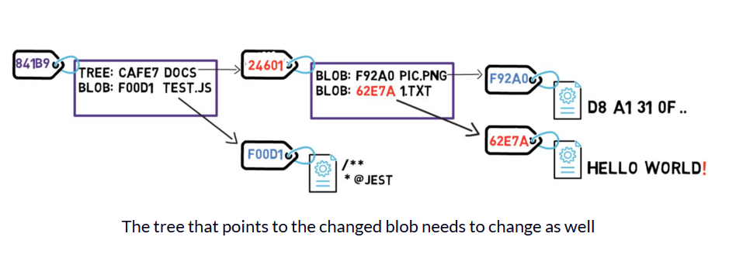

Slide 21
EXAMPLE
And now, since the hash of that tree is different, you also need to change the parent tree — as the latter no longer points to tree CAFE7, but rather to tree 24601. Consequently, the parent tree will also have a new hash.

Slide 22
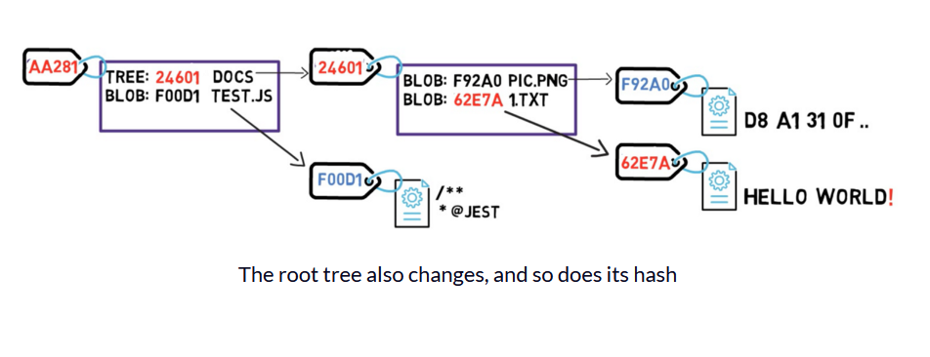

Slide 23
EXAMPLE
Since this commit is not the first commit, it also has a parent commit — commit A1337.

Slide 24
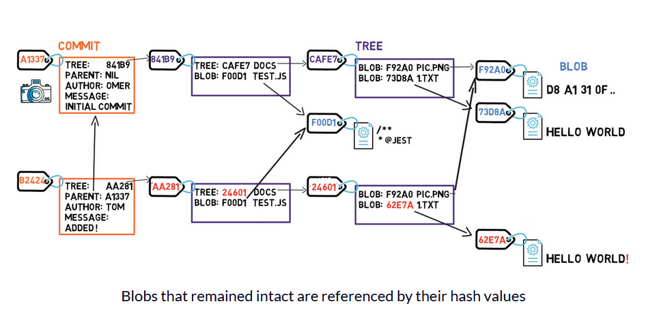

Slide 25
RECAP Git Objects
To recap, in this section we introduced three Git objects:
Blob — contents of a file.
Tree — a directory listing (of blobs and trees).
Commit — a snapshot of the working tree.

Slide 26
Main Objects
Branches IN Git

Slide 27
Branch
A branch is just a named reference to a commit.
You can always reference a commit by its SHA-1 hash, but humans usually prefer other ways to name objects. A branch is one way to reference a commit, but it's really just that.

Slide 28
GIT INIT
In most repositories, the main line of development is done in a branch called main. This is just a name, and it's created when you use git init, making it widely used. However, you could use any other name you'd like.
Typically, the branch points to the latest commit in the line of development you are currently working on.

Slide 29
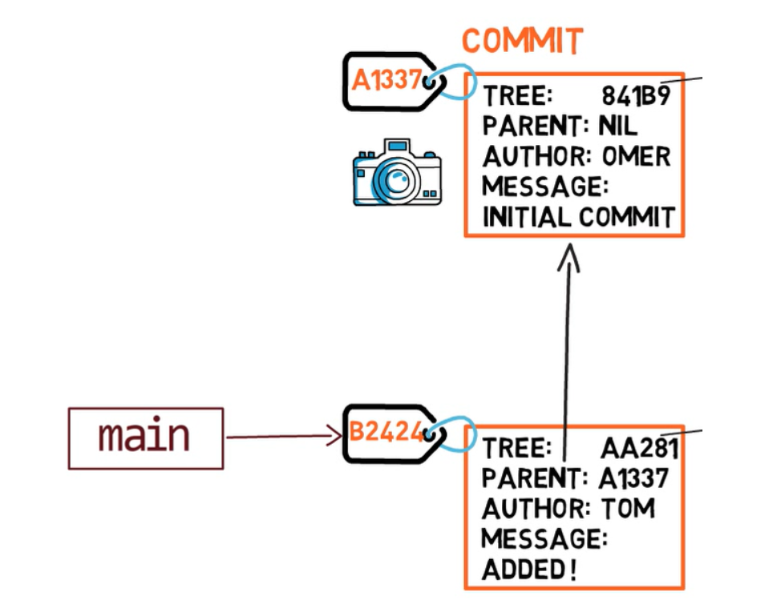

Slide 30
GIT BRANCH <name>
To create another branch, you can use the git branch command. When you do that, Git creates another pointer. If you created a branch called test, by using git branch test, you would be creating another pointer that points to the same commit as the branch you are on:

Slide 31
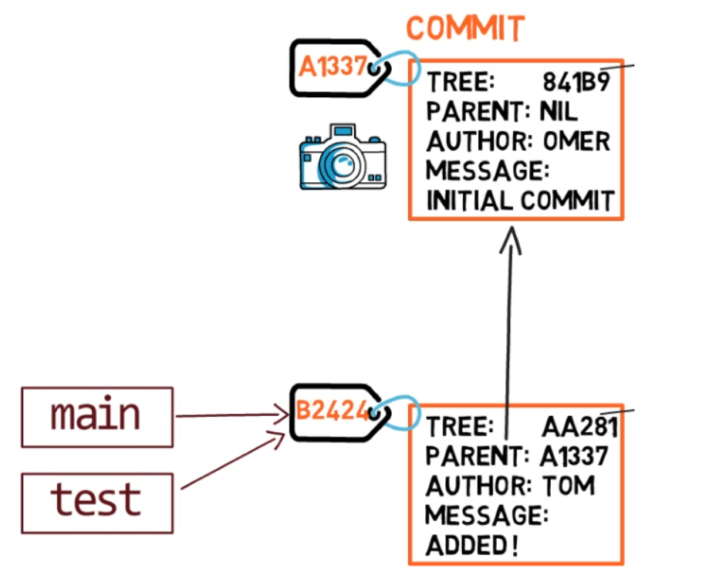

Slide 32
HEAD
How does Git know which branch you're currently on? It keeps another designated pointer, called HEAD. Usually, HEAD points to a branch, which in turns points to a commit. In the case described, HEAD might point to main, which in turn points to commit B2424. In some cases, HEAD can also point to a commit directly.

Slide 33
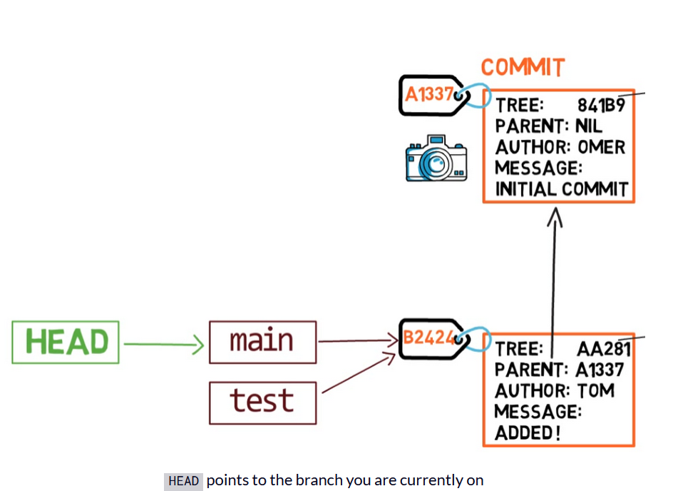

Slide 34
Git checkout <branch>
To switch the active branch to be test, you can use the command git checkout test, or git switch test. Now you can already guess what this command actually does — it just changes HEAD to point to test.

Slide 35
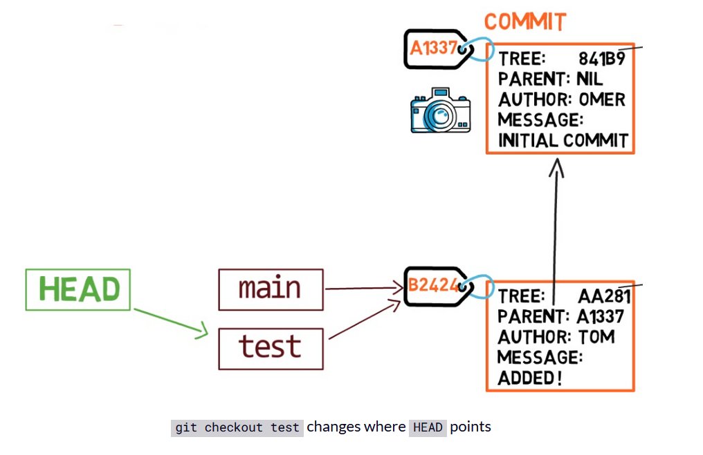

Slide 36
git checkout –b <branch>
You could also use git checkout -b test before creating the test branch, which is the equivalent of running git branch test to create the branch, and then git checkout test to move HEAD to point to the new branch.

Slide 37
head
At the point represented in the drawing above, what would happen if you made some changes and created a new commit using git commit? Which branch will the new commit be added to?
The answer is the test branch, as this is the active branch (since HEAD points to it). Afterwards, the test pointer will move to the newly added commit. Note that HEAD still points to test.

Slide 38
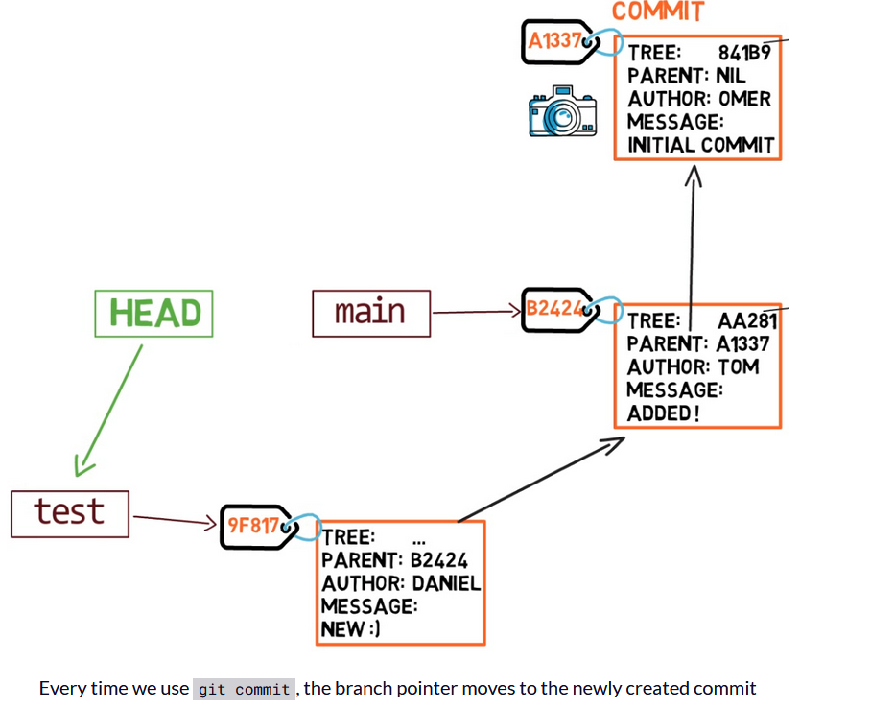

Slide 39
Git checkout main
If you go back to main by using git checkout main, Git will move HEAD to point to main again.

Slide 40
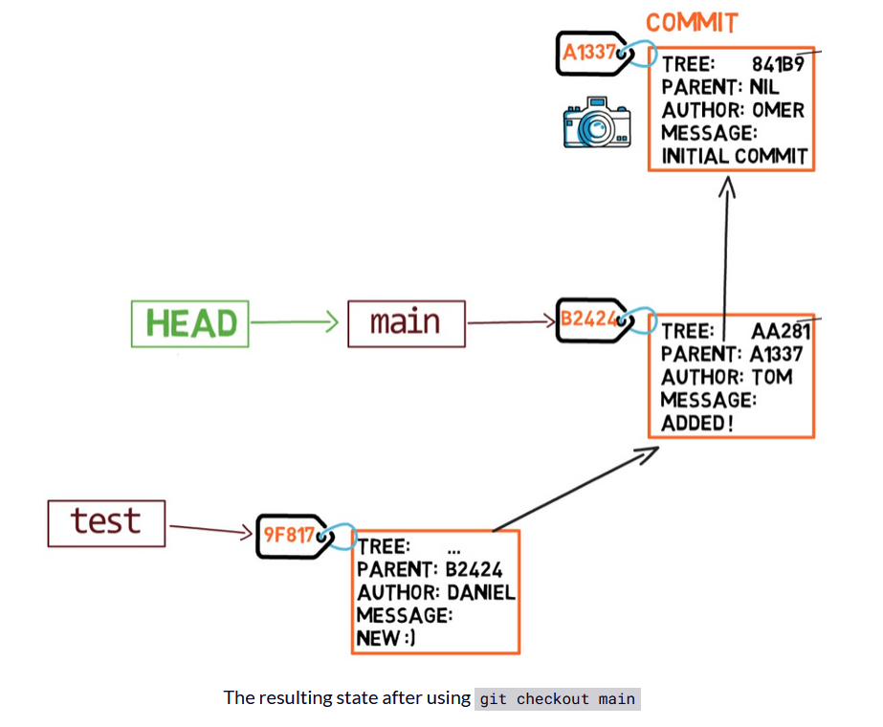

Slide 41
Example
Now, if you create another commit, which branch will it be added to?
That's right, it will be added to the main branch (and its parent would be commit B2424).

Slide 42
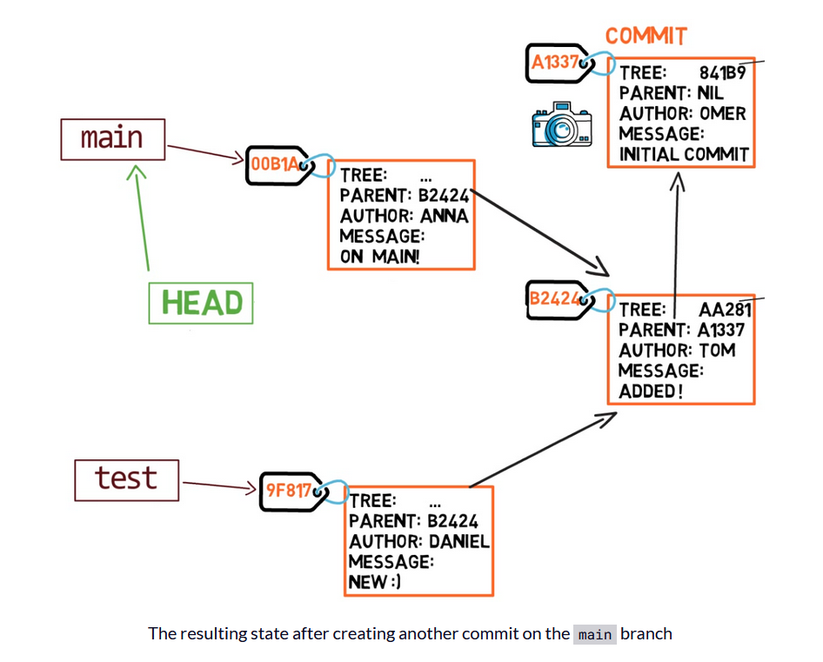

Slide 43
RECAP
A branch is a named reference to a commit.
When you use git commit, Git creates a commit object, and moves the branch to point to the newly created commit.
HEAD is a special pointer telling Git which branch is the active branch (in rare cases, it can point directly to a commit).

Slide 44
Main Objects
How to Record Changes in Git

Slide 45
GIT DIFF
git diff is a command that takes two inputs, and computes the difference between them. Inputs can be commits, but also files, and even files that have never been introduced to the repository.

Slide 46
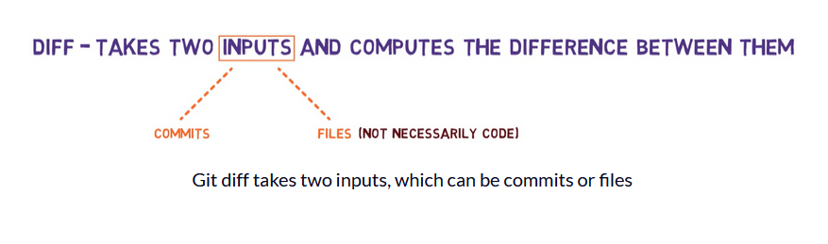

Slide 47
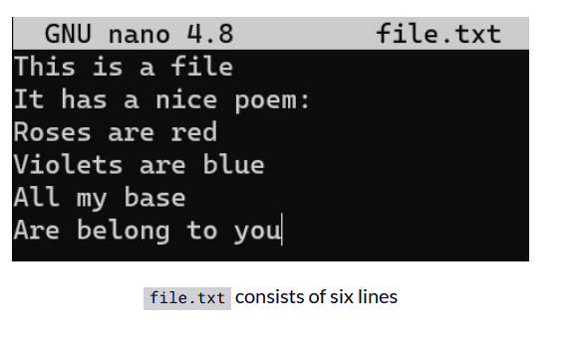
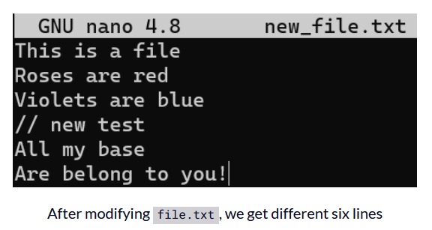

Slide 48
GIT DIFF
Now you can run git diff to compute the difference between the files like so:
git diff --no-index file.txt new_file.txt

Slide 49
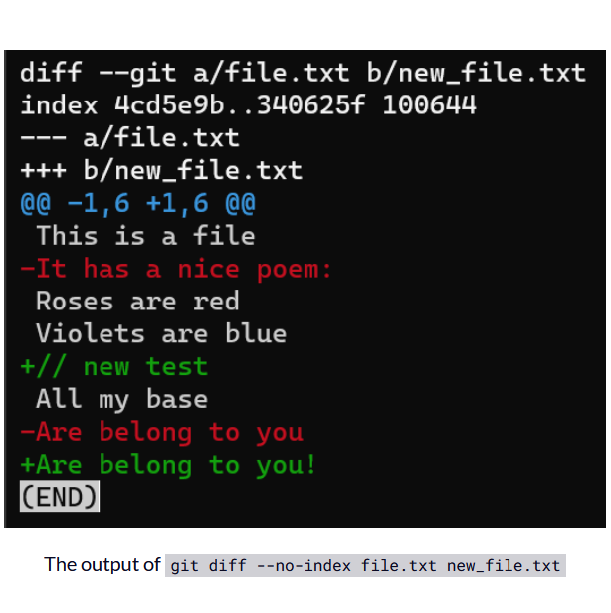

Slide 50
GIT DIFF
Interestingly, notice that Git views a modified line as a sequence of two changes - erasing a line and adding a new line instead. So the patch includes deleting the last line, and adding a new line that's equal to that line, with the addition of a !.

Slide 51
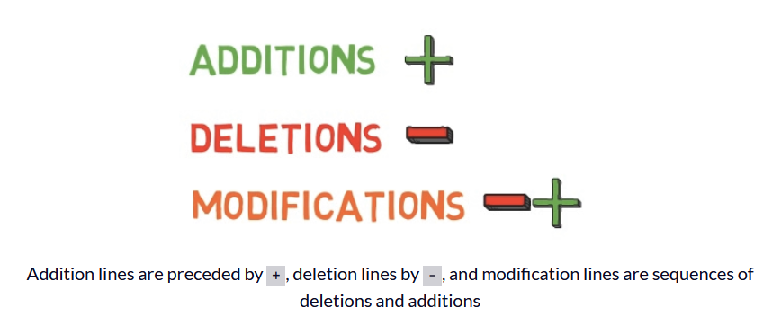

Slide 52
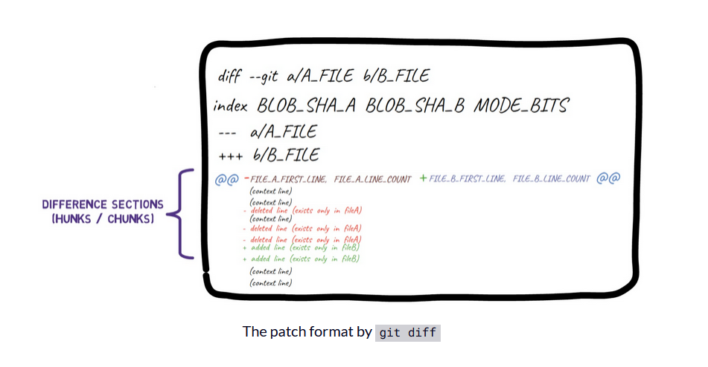

Slide 53
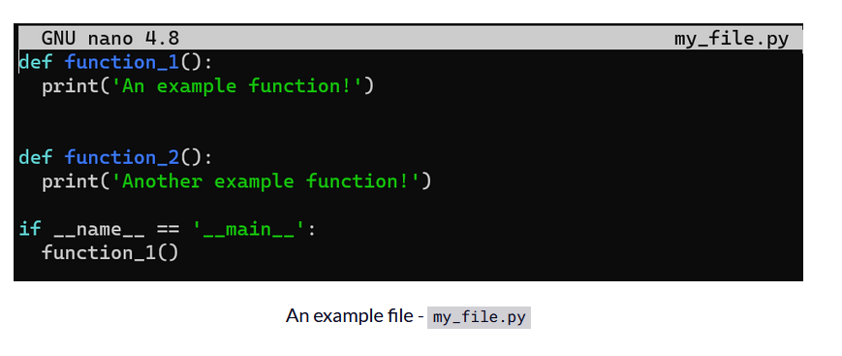

Slide 54
EXAMPLE
And change the second line from print('An example function!') to print('An example function! And it has been changed!'):

Slide 55
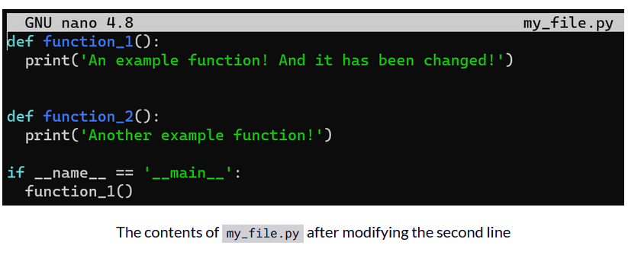

Slide 56
Example (Git diff)
Save your changes, but don't stage or commit them. Next, run git diff:

Slide 57
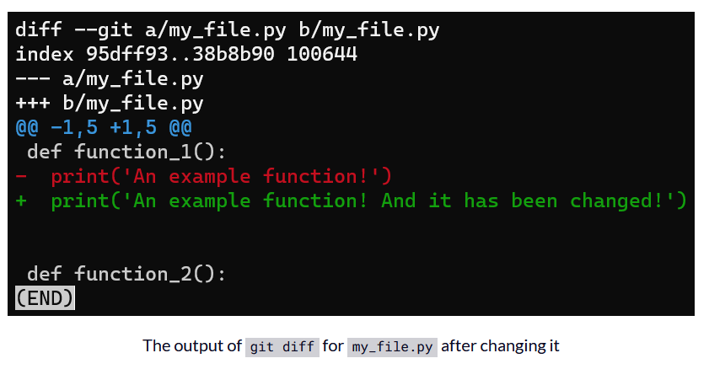

Slide 58
example
The output of git diff shows the difference between my_file.py's version in the staging area, which in this case is the same as the last commit (HEAD), and the version in the working directory.

Slide 59
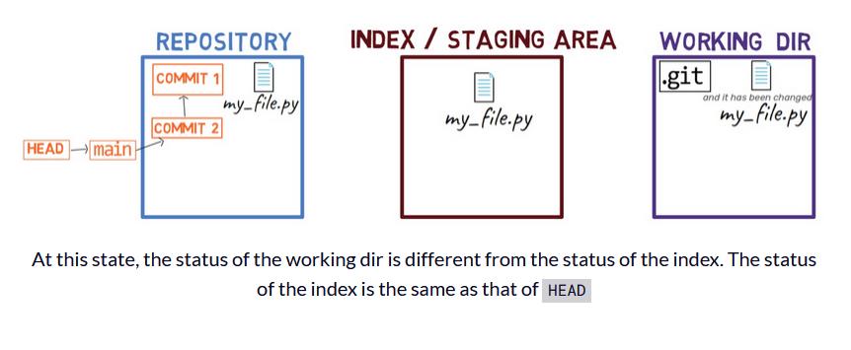

Slide 60
Example (Git diff)
To see the difference between the working dir and the staging area, use git diff, without any additional flags.

Slide 61
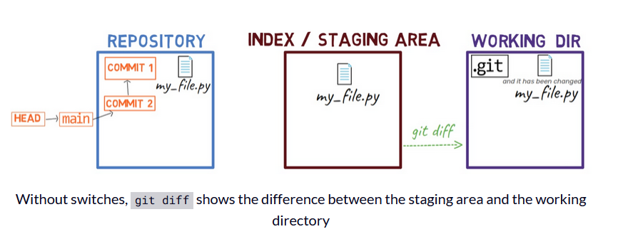

Slide 62
Example (Git diff)
As you can see, git diff lists here both file A and file B pointing to my_file.py. file A here refers to the version of my_file.py in the staging area, whereas file B refers to its version in the working dir.

Slide 63
Example (Git diff)
We can provide a few switches to git diff to get the diff between the working dir and a specific commit, or between the staging area and the latest commit, or between two commits, and so on.
First create a new file, new_file.txt, and save it:

Slide 64
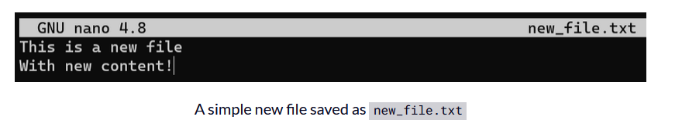

Slide 65
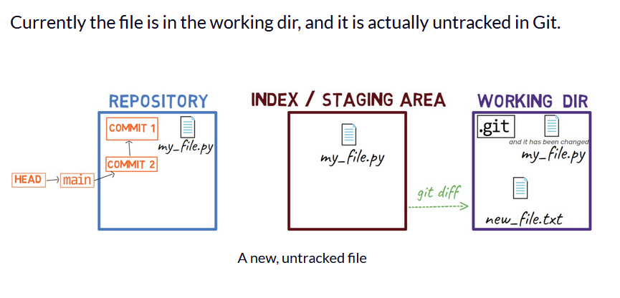

Slide 66
EXAMPLE (GIT ADD, GIT COMMIT)
Now stage and commit this file:
git add new_file.txt
git commit -m "Commit 3"

Slide 67
EXAMPLE
Now, the state of HEAD is the same as the state of the staging area, as well as the working tree:

Slide 68
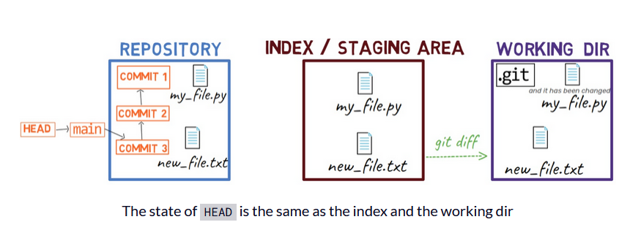

Slide 69
example
Next, edit new_file.txt by adding a new line at the beginning and another new line at the end:

Slide 70
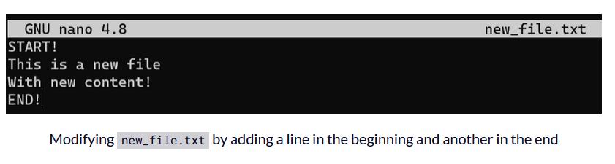

Slide 71
example
As a result, the state is as follows:

Slide 72
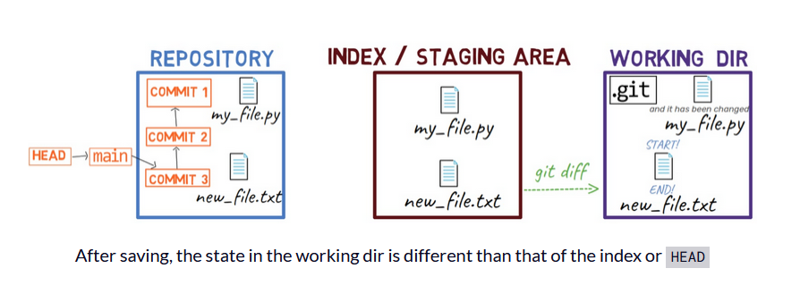

Slide 73
GIT (ADD –p)
A nice trick would be to use git add -p, which allows you to split the changes even within a file, and consider which ones you'd like to stage.

Slide 74
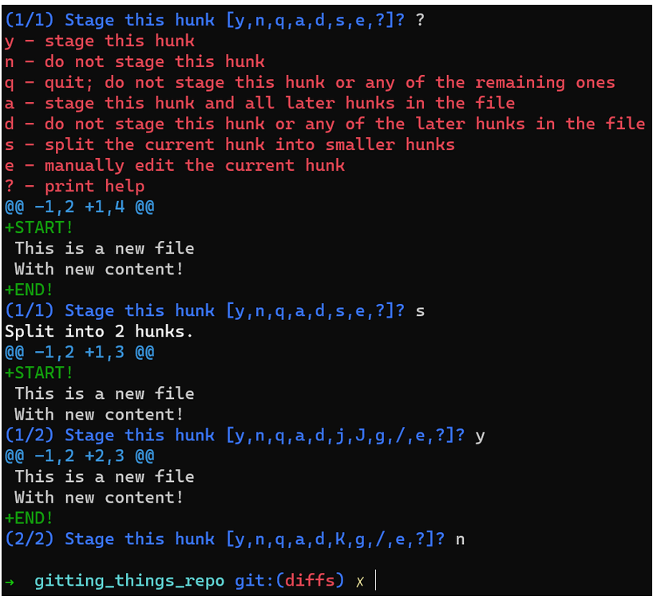

Slide 75
example
So now the state in HEAD is without either of those new lines. In the staging area you have the first line but not the last line, and in the working dir you have both new lines.

Slide 76
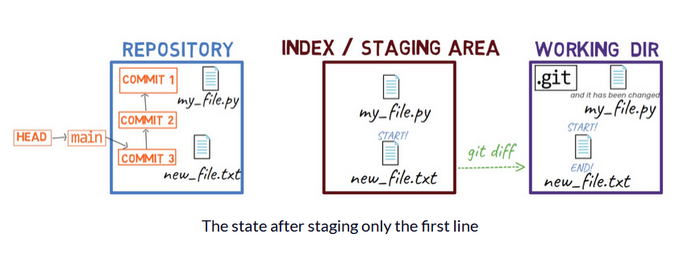

Slide 77
EXAMPLE
Well, as stated before, you get the diff between the staging area and the working tree.

Slide 78
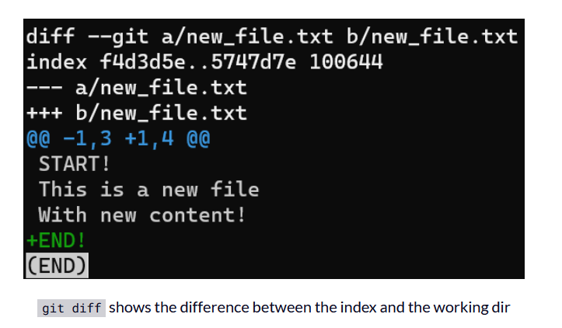

Slide 79
Example (Git diff –cached)
What happens if you want to get the diff between HEAD and the staging area? For that, you can use git diff --cached:

Slide 80
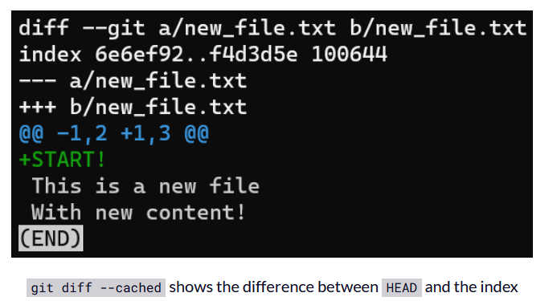

Slide 81
Example (Git diff head)
And what if you want the difference between HEAD and the working tree? For that you can run git diff HEAD:

Slide 82
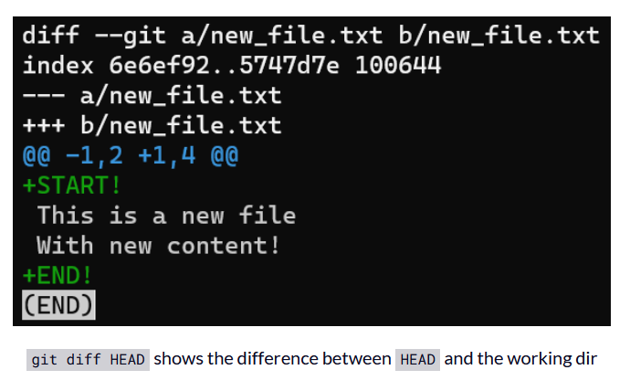

Slide 83
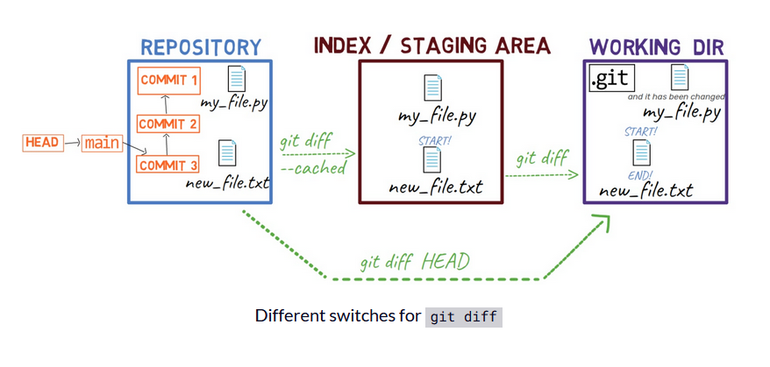

Slide 84
Example (git diff --no-index)
As a reminder, at the beginning of this chapter you used git diff --no-index. With the --no-index switch, you can compare two files that are not part of the repository - or of any staging area.

Slide 85
Example (git commit -m)
Now, commit the changes you have in the staging area:
git commit -m "Commit 4"

Slide 86
EXAMPLE (git diff HEAD~1 HEAD)
To observe the diff between this commit and its parent commit, you can run the following command:
git diff HEAD~1 HEAD

Slide 87
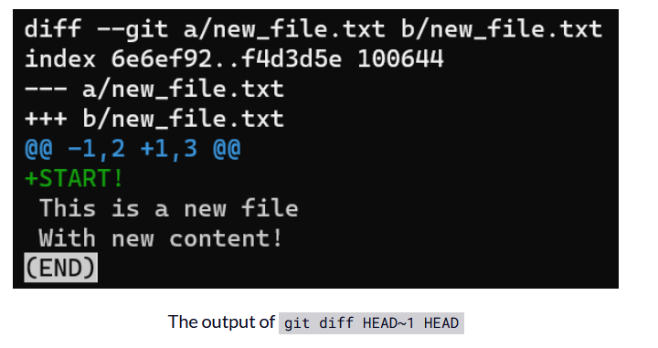

Slide 88
EXAMPLE
A short way to view the diff between a commit and its parent is by using git show, for example:
git show HEAD
This is the same as writing:
git diff HEAD~ HEAD

Slide 89
EXAMPLE
To summarize all the different switches for git diff we covered in this section, see this diagram:

Slide 90
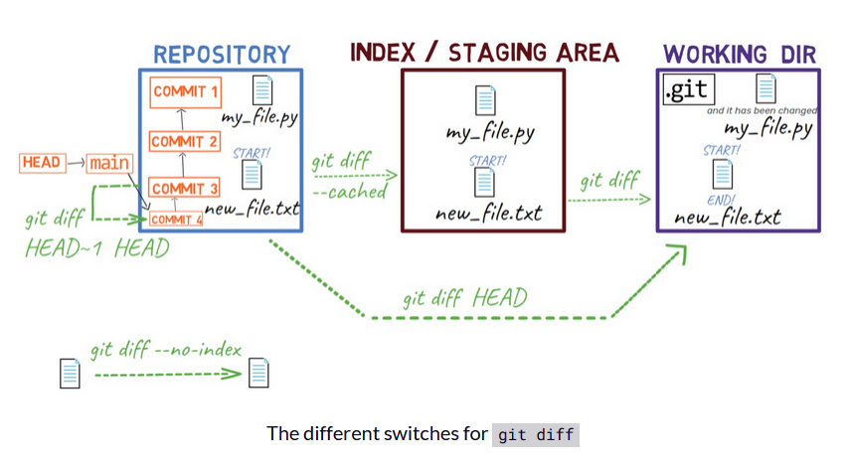

Slide 91
Recap - How to Record Changes in Git
You learned about the three different "states" of the file system that Git maintains:
Working dir(ectory) (also called "working tree") - any directory on your file system which has a repository associated with it.
Index, or the Staging Area - a playground for the next commit.
Repository (in short: "repo") - a collection of commits, each of which is a snapshot of the working tree.

Slide 93
TODO
DOCUMENT WITH GIT COMMANDS

